Slide 1
Online Safety

Slide 2
Introductions
Miss Sherry – Head and DSP
Mr Rutherford – Wellbeing lead and DSP
Mrs Cooper – teacher and online safety lead CEOPs ambassador
Miss Cassidy – teacher and PSHE lead
Other DSPS- Miss Keighley, Mr Long

Slide 3
From 1st September 2026, the new Department for Education (DFE) guidance came into effect.
There is now a greater emphasis on online safety and children’s wellbeing when online.

Slide 4
Why is online safety so important?

Slide 5
Why is online safety so important?
By the age of nine 10% of children report seeing pornography
By age 11 this goes up to 27%
79% had encountered violent pornography by age 18
Twitter was the platform where most children reported accessing porn
Instagram and Snapchat were also named, now we would include TikTok
None of the issues that we deal with involve a phone/device/gaming account owned by the child!
The police get involved.
Childrens Commisioner UK GOV

Slide 6
Devices in school
Phones or devices cannot be out in school- the gates are the boundary
Phones and devices are allowed to be brought in when the children are older but must be left, at the child’s risk, in the class box. The alternative is to leave at home. The same now applies to many secondary schools.
This includes smart watches, an IPAD because you are going to Dad’s this weekend etc
If a fitbit is distracting a child – they will be asked to hand it in to a teacher

Slide 7
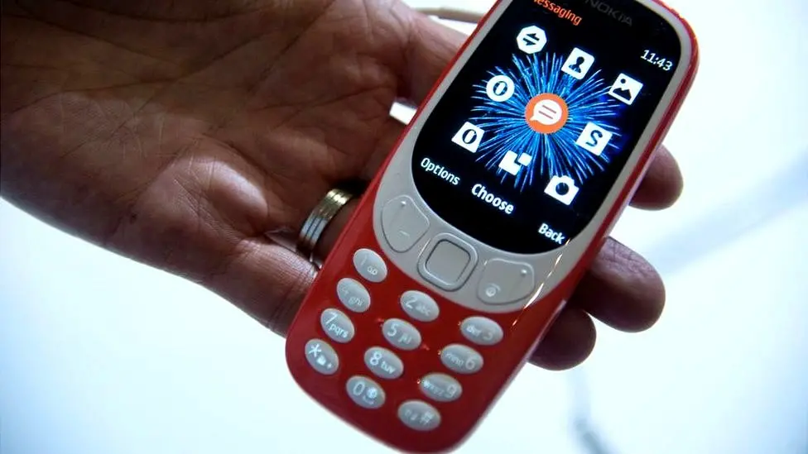
Not smart but clever? The return of 'dumbphones' https://www.bbc.co.uk/news/business-60763168

Slide 8
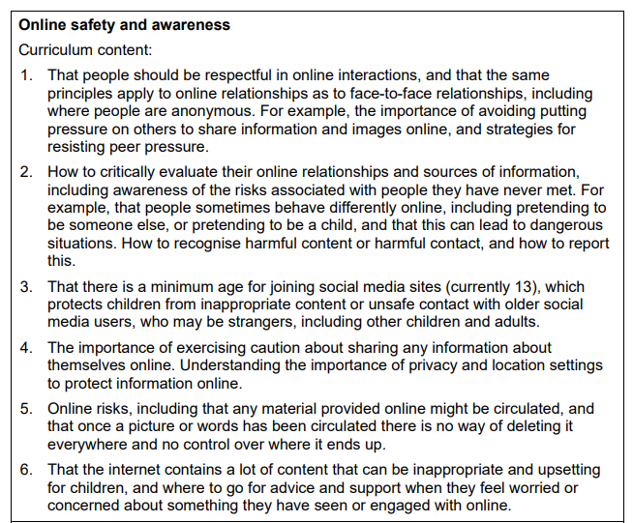
Taken from statutory guidance:
(Relationships education, Relationships and sex education RSE and health education, July 2025)

Slide 9
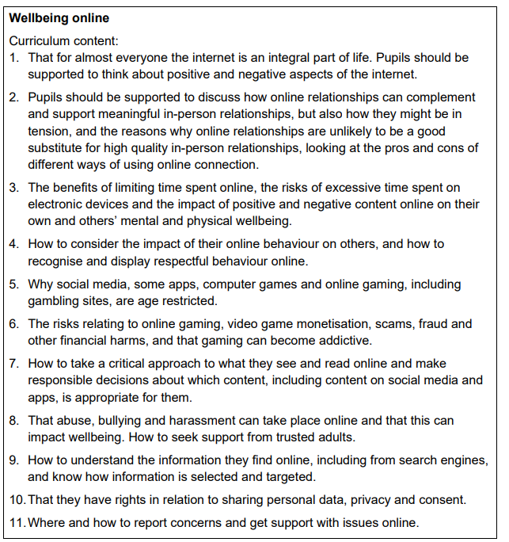
This is part of the end of primary school expectations for health and well-being.
Taken from statutory guidance:
(Relationships education, Relationships and sex education RSE and health education, July 2025)

Slide 10
We follow the Jigsaw Scheme of work for PSHE.
- This scheme follows the statutory guidance for PSHE and has been updated for September 2026.
- All children complete the same topic at the same time but on an age appropriate level.

Slide 11
Within the Jigsaw PSHE curriculum, the main changes are:
The guidance has expanded expectations around online safety.
• New content on how search engines rank and select results
• Teaching about how online content is selected and targeted
• Enhanced SMARRT rules with Safety STAR integration
• Updated content on AI technology and automatic filters (e.g. in body image lessons)
• Strengthened content on digital spending risks, in-game purchases, and keeping personal information safe
• Updated content on the permanent nature of digital content and legal implications

Slide 12
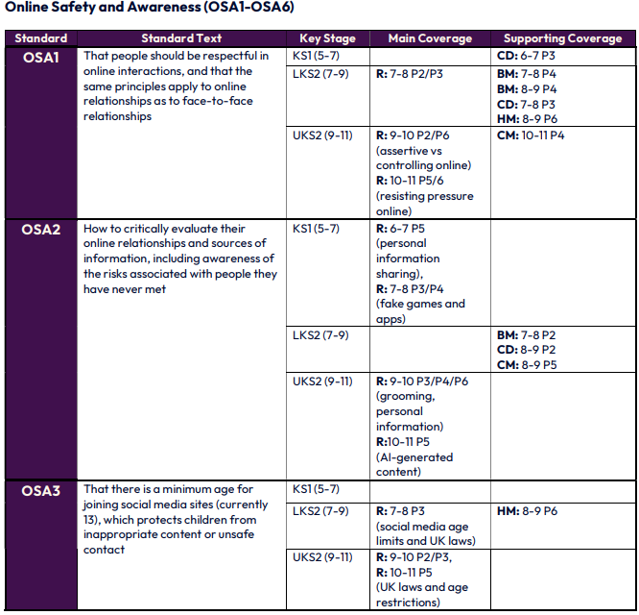
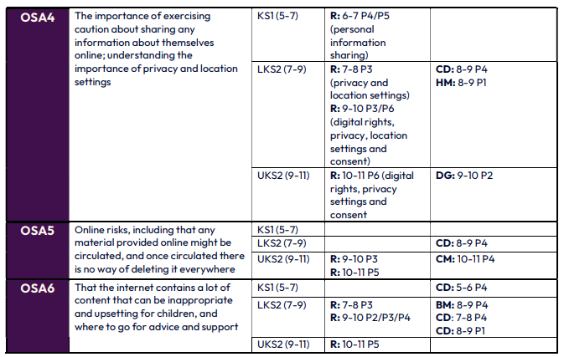
Where is Jigsaw following the DFE Guidance?
Jigsaw follows the guidance in all areas. Below is an example for online safety and where it is covered:

Slide 13
Devices in homes- what can you do?
No phones upstairs rule?
Locks on how much time your child can access their phone?
We often get sent screenshots of ‘chats’ and these show that children were messaging at 3am!
No phone parties/sleepovers?
Modelling being present and off your phone?
Double screening? Phone and tv or phone and laptop?
Brick phones???

Slide 14
Parental controls
https://www.knowsleyclcs.org.uk/wp-content/uploads/2026/07/Parental-Controls-booklet-2026.pdf

