Slide 1

SATS 2026
MONDAY 11th May - GRAMMAR, PUNCTUATION, SPELLING
TUESDAY 12th MAY – READING
WEDNESDAY 13th MAY – MATHS PAPER 1 & 2
THURSDAY 14th MAY – MATHS PAPER 3
FRIDAY 15th MAY - NO TESTING Dress up day!

Slide 2
What are SATs?
They are end of Key Stage assessments that assess what the children have learnt over Years 3-6.
They assess Reading, Maths, Grammar Punctuation and Spelling.
They are used to ascertain progress from KS1-KS2 and whether the children are leaving their primary education at 'age-related' expectations and whether they have the required skills ready to start Year 7.
The marks they achieve form the beginning of the children's GCSE pathways. Secondary schools will have to look back at these results to form their predicted outcomes.

Slide 3
What happens during the week?
SATs breakfast everyday – 8:30am
Testing under strict timetable and examination conditions every morning up until lunchtime
Children may be spread out over other classrooms depending on 'access arrangements' and what is best for them.
Test papers collected, sent away for marking
Results in July
Notes:
Being away/late means that they will not have a result for that test.
If they come in same day then they are isolated from rest of year group until their test can be completed.
Access arrangements mean that some will have qualified for extra time/reader/scribe. We have tested children for this as have to prove that they need this to succeed (equity) and that it is normal practise
Please do not ask us how the children went – we do not see their test papers until returned after results in July.
You will receive a printed report with whether they have achieved the expected standard or not in each test.

Slide 4
What can you do at home?
Make sure your child attends school on time everyday
Please do not make any appointments during test times
Ensuring children have reasonable bedtimes and are well-rested
Come to school with the correct equipment each day
Keep pressure to a minimum – avoid 'cramming' and last-minute studying every day during the test week
Allow time to decompress and relax
Water and snack – particularly on heavy testing days

Slide 5
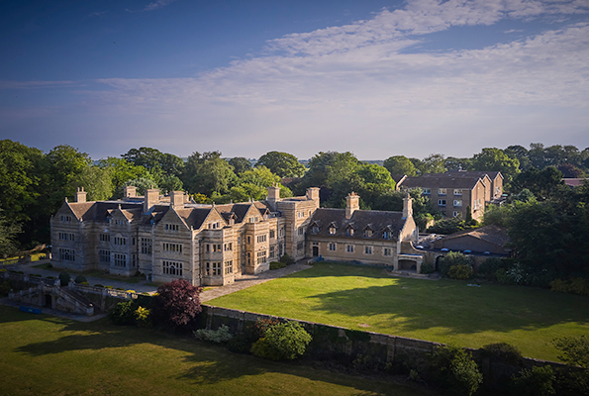
Year 6 Residential
Caythorpe Park 2026

Slide 6
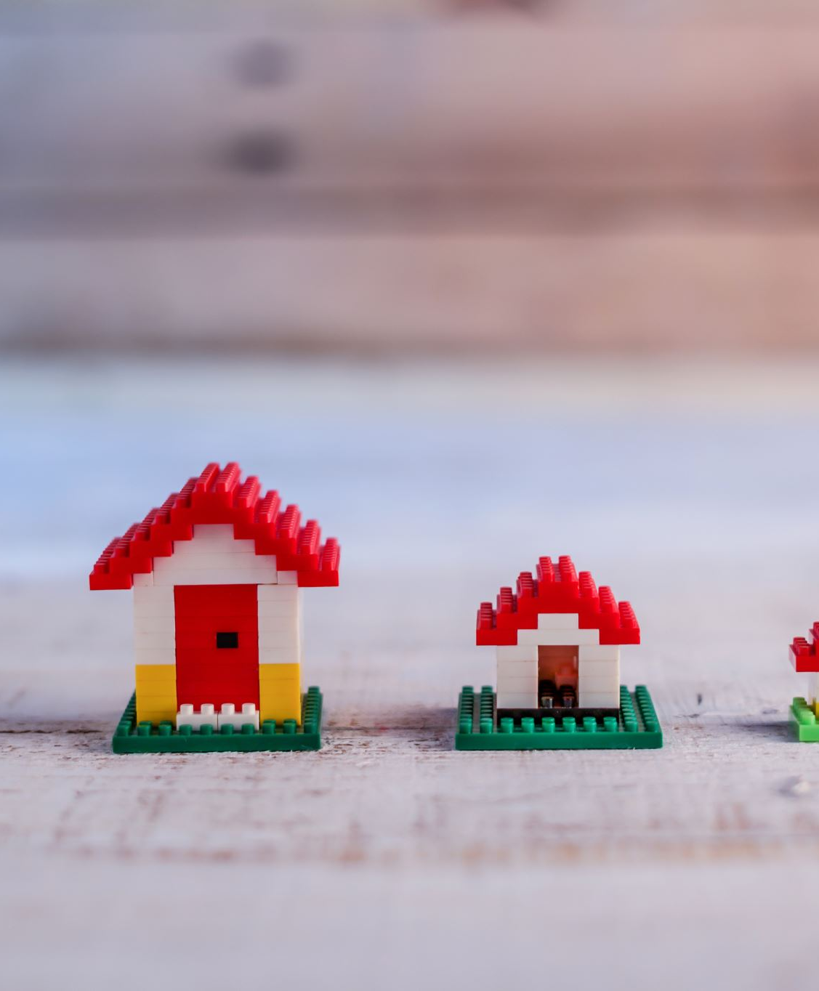
Monday 8th June 2026 – Friday 12th June 2026
Arrive at school normal time – children and luggage to school hall via Year 3/4 gate on Bellmount Wood venue.
Coaches leaving at 9:30am and will be arriving to Caythorpe Court around 12pm
Children will need a packed lunch on the first day in disposable packaging.
Leaving Caythorpe Court at 2pm and arriving back approximately 5pm (TBC)

Slide 7
Kit List
Sleeping bag and pillow
2 x towels
Water shoes/old trainers + other trainers for dry activities
Hat and suncream
Tops that cover shoulders
Shorts that cover thighs
£10 in coins/£5 and coins for gift shop in a named envelope and handed to the school office
See handouts for more info
**A more comprehensive tick-list will be given out closer to the time.

Slide 8
What not to pack in bags...
Mobile phones*
Other Electronics – torches, games, toothbrushes, hairdryers
Cameras
Aerosols
Extra money
Snacks/any food other than the packed lunch for the first day
*Medication, herbal remedies, creams that are nut based
Notes:
Starred ones mobile phones and mediations – emphasise risks with these.
These are the rules we have put in place to keep every child safe and to work with us, these need to be respected. Saying to your child that its ok for them to do this one thing then undermines every other rule.

Slide 9
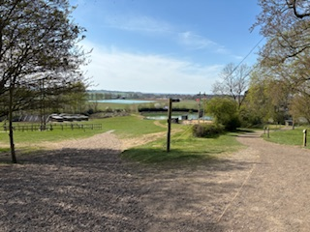
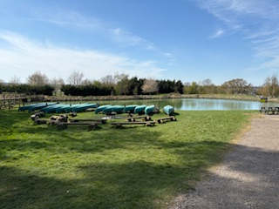
Activities, Facilities and Safety
Day: trapeze, orienteering, abseiling, giant swing, raft building, high ropes, climbing, zip wire, problem solving, fencing, archery
Evening: camp fire, disco, cluedo, balloon splash
Mixed groups across the year group that are the same for the whole week – they will be with a leader from the centre and one of our staff from Cassiobury
Activities are their lessons for the week and the Cassiobury school rules will apply – it is crucial that they listen attentively to all instructions as it is imperative to their safety.
If your child is deemed to not be acting in a way that is safe for them and others, they will have to sit out of that activity.
Your child will be encouraged to have a go but no one will be forced.

Slide 10
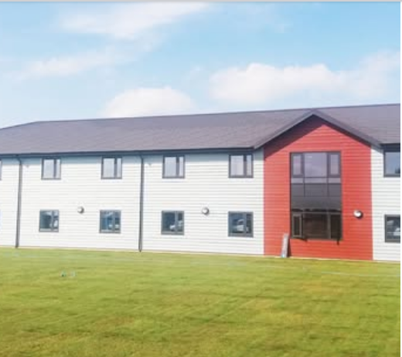
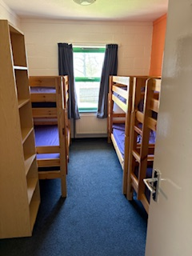
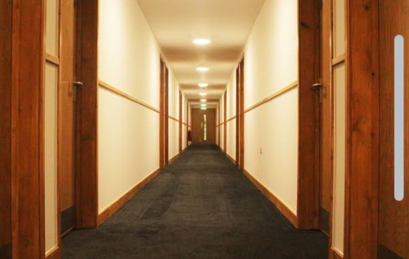
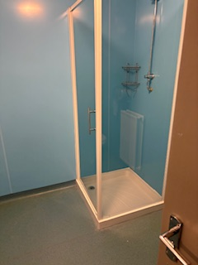
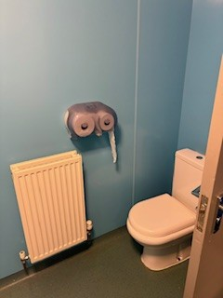
Sleeping Arrangements –
Building: The Vales, Cranwell (accommodation block)
Rooms of 6
All children will have at least one person of their choice with them in their room. Where possible we will try and group based on what we know about their friendship groups and who they like to spend time with. Sometimes this is not always possible due to the nature of numbers.

Slide 11
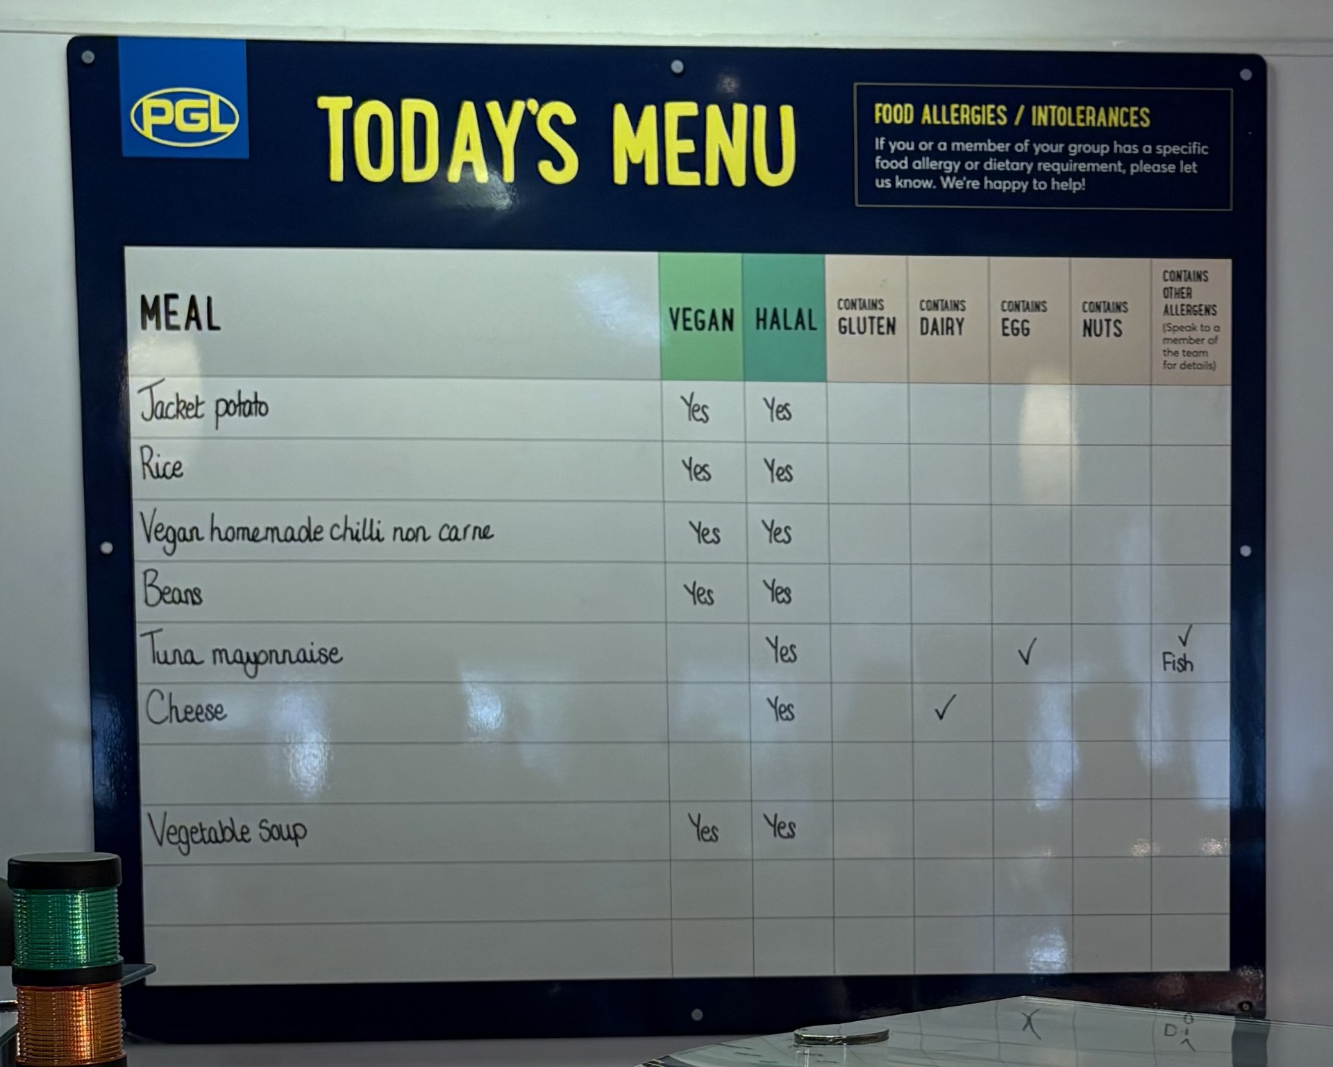
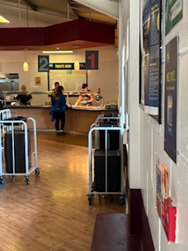
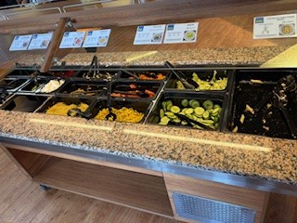
Form for filling out specific requirements for food e.g. halal, vegetarian, vegan, dairy free, allergies etc.
***Please only inform us about the above – your child will choose from the selection that is on offer for each meal.
Food and Dietary Requirements

Slide 12

Medical
Designated first aider from the Cassiobury team plus all PGL leaders are first aid trained.
Medical forms to fill in if your child requires specific medication whilst on the trip – no ‘just in case’ medication
We take the basics and parents will consent on the gateway to us using this if required – we will always let you know if we have had to administer any medication.
In case of emergency... If you need to get in contact with us urgently, please go through the school office. The phone number for the centre should only be used in extreme circumstances.

Slide 13
Medication
Must be labelled clearly with name and class.
Must have precise dosage instructions on them .
Must be handed to Mrs Maistry/Mr Rutherford on Monday morning.
INHALERS (Two)– one should be with your child and a spare should be handed in as a spare. Both should be labelled with NAME and SCHOOL.
Travel Sickness – We will give any medication before we go.
For return journey, please put medication in an envelope with your child’s name and class on the front as well as clear instructions relating to dosage and timing.
Notes:
Last year we had many people turn up on the Monday morning without two inhalers or the correct medication
All medication needs a form

Slide 14
Letter Writing
It is essential that you write while we are away
- please make your letters upbeat and positive to
keep home-sickness at bay!
(Letters can be given to Mrs Potter before we leave if you do
not want to rely on the post).
Please make sure you include
Your child’s name AND
c/o Cassiobury Junior School (Boston House)
as there are so many different schools & children on site.

Slide 15
What we will share with parents
BEFORE
Meeting for all those attending in Summer 1
Exact details including departure times, timetable, specific kit lists, forms to fill in including dietary, medical, medications
DURING
Updates and photos subject to time and wifi reception
Letters sent from your children
AFTER
Photo Album from the trip
Some very tired but happy children – can’t promise level of cleanliness

Slide 16
What to do in-between now and the 8th June
Make sure you have paid the deposit and are up to date with payments if you have not already
If your children have never experienced a sleepover type situation before, it might be worth setting some of these up.
SWIMMING!
Encouraging independence with clothing, equipment, getting up, showering, daily tasks etc.
Practice packing their own case and making up a bed – they will have to do this
Teach them some card games/find a new game that they could teach their peers.
Ensuring that all emails and forms sent by the office have been acknowledged, filled out and returned by the deadlines.

