Slide 1

Meet the Teacher 2025-26
YEAR 6
Cassiobury Junior School

Slide 2

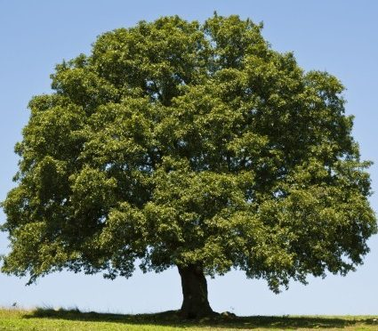
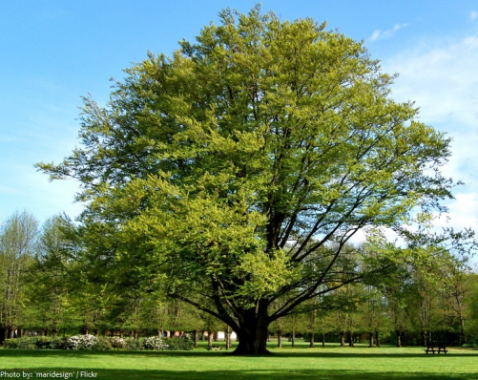
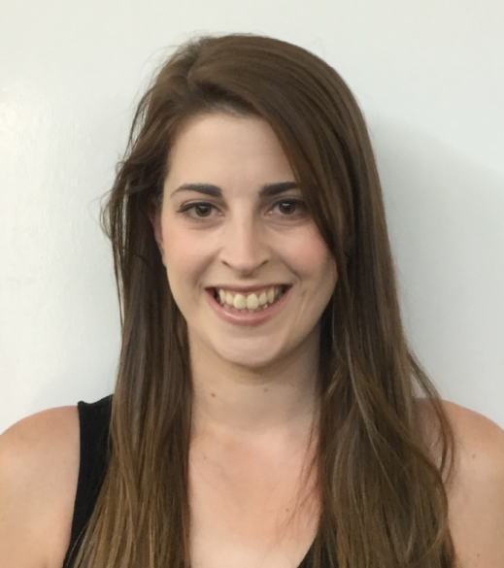
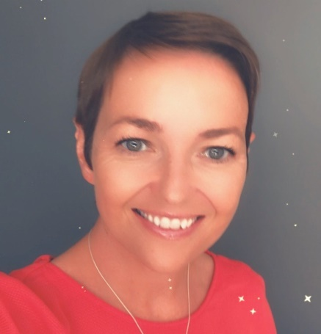
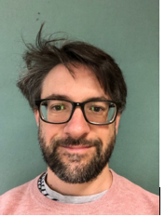
Meet the Team
6 Maple – Miss Keighley
6 Oak – Mrs Potter
6 Beech – Mr Long
Mrs Taylor (Thursday and Friday)
Mrs Amaranath, Mrs Jain, Mrs Maistry, Mrs Dearman (PPA)

Slide 3
Year Group Expectations
Becoming Secondary ready
A large part of Year 6 is to prepare the children for Year 7. To become ‘secondary ready,’ key skills we are hoping to develop are:
Independence and organisation - looking after their own equipment, revision, packing their own bags, knowing and working from a timetable, taking responsibility for home learning.
Communication - talking to us if there is a problem, participating effectively in group, pair and whole class learning, asking for help.
Behaviour for learning - supporting peers, active participation, perseverance, resilience, trying new things, teamwork, growth mindset
Setting a good example – Year 6 are the role models and need to take responsibility for their own actions both in the classroom, on the playground and within the community (including coming to and from school).
Managing tests and assessments - revision, strategies for managing anxiety and stress, how to sit a test.
WORK WITH US: Emails – deadlines, information, responding
Supporting your child in all elements of the curriculum – including swimming, cycling and bikeability
Year book

Slide 4
Homework
All done in home learning book (pink book) provided at beginning of year
Daily reading - Reading 5 times per week for approximately 30min. This is in order to build stamina. At least one of these sessions should be with an adult. Every time you read you should be filling out your reading record with thoughts, reflections, tricky words etc.
Maths home work: Set on Thursday and due on Tuesday. Includes: consolidating concepts from the week, repeated practise and recall of multiplication and division facts to 12 x 12.
Spellings (4 sets). These will be tested on Tuesday after practice throughout the week at school and at home. Spellings and the associated activities are to be done by hand, not typed.
On occasion, additional tasks may be sent home to support the learning that has been done in class.
Home learning that we do is aligned with concepts that are tested in SATs. If you want to know how to help your child for the SATs, support your child with their home learning.
OTHER HOME LEARNING TASKS WILL BE POSTED ON GOOGLE CLASSROOM

Slide 5
Curriculum Overview
**Look out for the Curriculum Newsletters each term**
Reading – Fluency and comprehension
WWII Historical fiction
Science – Circulatory system and Light
Art – Pop Art
Writing – Narrative (suspense) and Non-Chronological Report (planets and space)
PSHE – Being Me and Celebrating Differences
Maths – Place Value and Number, Four Operations
History – WWII (leadership, innovation and daily life)

Slide 6
Equipment
To encourage responsibility and independence, Year 6’s will be required to bring their own equipment for learning and will need to monitor when they need to replace. This includes:
A pencil case – must be able to fit in personal trays
Writing pencils – more than one
Good quality handwriting pens in blue – more than one
2 black fine liners
Sharpener with a pot
Eraser
Coloured pencils
Highlighters – set of colours
Glue stick
Ruler – 30cm with millimetres shown
1 lever arch folder – A4 sized
A journal – lined pages
REPLENISH TERMLY!

Slide 7
Phones and Devices
Year 6 is where we see a big increase in phone or device related incidents
Know your child’s phone/device – how do they talk to others, what are they viewing, what apps are they using
Responsibility lies with the owner of that phone
Please respect and help us to reinforce the rules that we set for phone use at school/on trips

Slide 8
Things to look forward to in Year 6
Having more responsibilities and jobs – building independence and trust
Working with all the Year 6 teachers, not just the class teacher in lesson rotations and groups
Young Voices – 4th Feb
Bikeability - May
Curriculum trips and visits
Themed dress up days
Residential trip is booked for week beginning the 8th June for 5 days away
Leavers production and assembly - Summer

Slide 9

Residential
Caythorpe Court – Lincoln
8th June – 12th June 2026
One of the best experiences your child will have in primary school
Adventurous activities, team work, leadership, independence
Meeting in April (approx.) date to be confirmed
Deposit is due ASAP (today!!!)

