Slide 1

Welcome to Year 4

Slide 2
Hawthorn
Hazel
Mrs Waddington
Ms Patel
Ms Georgiou
Miss Negru
Mrs Santilale
Holly
Miss Butler
Mrs Dearman

Slide 3
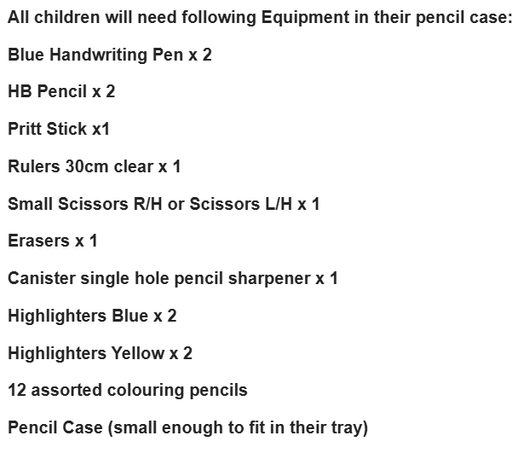
Equipment expectations
pencil cases
water bottles
Coat
PE kit in everyday

Slide 4
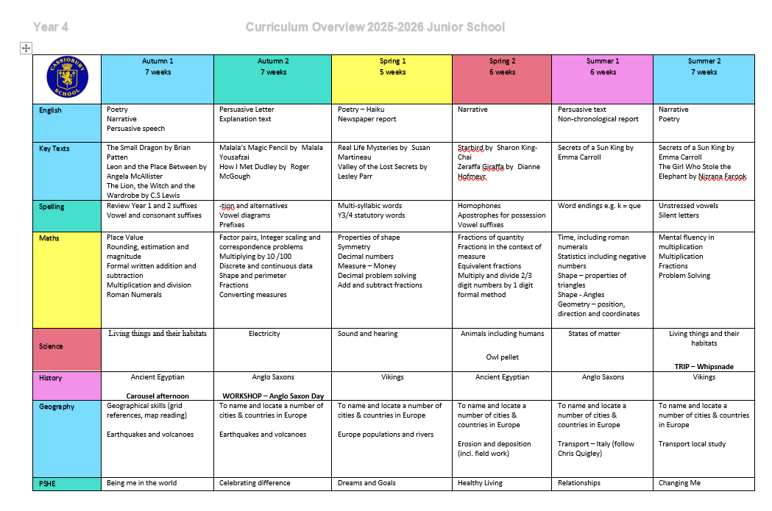
Curriculum

Slide 5
Curriculum
The curriculum newsletter
Trips and visits – The Lion, the Witch and the Wardrobe theatre trip, Whipsnade zoo, Anglo Saxon day, Advent visit, Owl pellet workshop
Production for the year group (Spring 2)
Year 4 Times table Test (June)

Slide 6
Library - Thursday
New library scanning system
1 book in and 1 book out
Read quietly

Slide 7
Homework
Available on google classroom every Friday and in Homework book
e.g. p.jones@cassioburyjm.org.uk
password: pj170514
It will consist of;
reading (10 minutes to an adult at least 3 three times a week and recorded in the log)
Times table revision - written, games, TTRS (no evidence required),
Spellings - 10 words

Slide 8
Adult volunteers
Readers
Trips
Workshops in school

