Slide 1

Welcome to Year 3

Slide 2
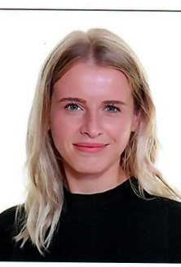
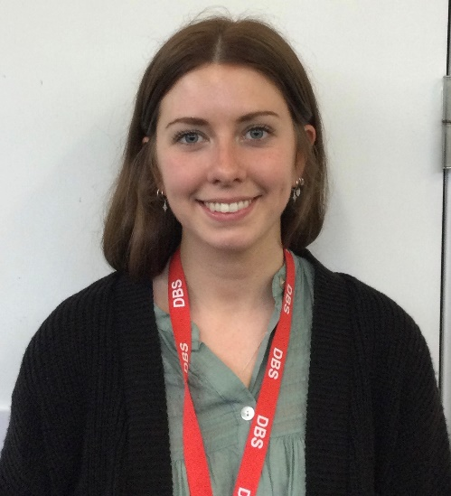
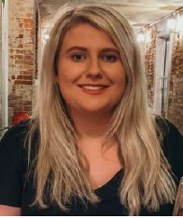
Meet the Team
Apple
Alder
Ash
Miss Pollard
Miss Rosewall
Miss Cassidy
Year 3 TA’s –
Ms Georgiou, Miss Ibia, Ms O’Connor, Mrs Patterson, Miss Macgregor, Mrs Roberts

Slide 3
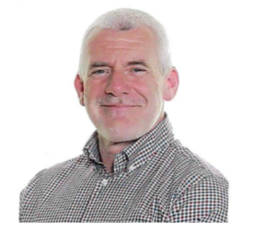
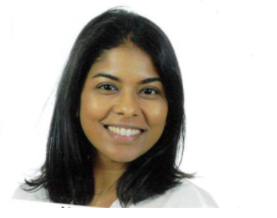
Mr Rutherford
Wellbeing lead
Mrs Newman
SENCO and Inclusion Lead

Slide 4
Other key staff members…
Mrs Clarke and Mrs Harrison- office
Mrs Campbell- School business manager
Mrs Halward- Site manager
Miss Keighley- assistant head
Mr Long- assistant head
Miss Sherry- headteacher

Slide 5
Birthday/Celebration Sweets or Food
We do not distribute sweets or food due to the range of allergies and food rules within the school

Slide 6
Year 3 PE days
All year 3 classes will have PE on Tuesdays.
Alder and Apple = Friday
Ash = Wednesday
Children should have their PE kit in school all week. They will be expected to change back into their uniform following PE lessons.
If your child has ear piercings please teach them to remove these. Piercings can only be taped for the first 6 weeks.

Slide 7
Trips and Additional Learning Opportunities
We plan to do three school trips/ additional learning opportunities over the academic year, one per term, these will be related to learning.
For trips and additional learning opportunities to happen we will need parent volunteers this information will be sent out with the trip information.
We have provisionally booked
Cassiobury Farm
Science Workshop

Slide 8
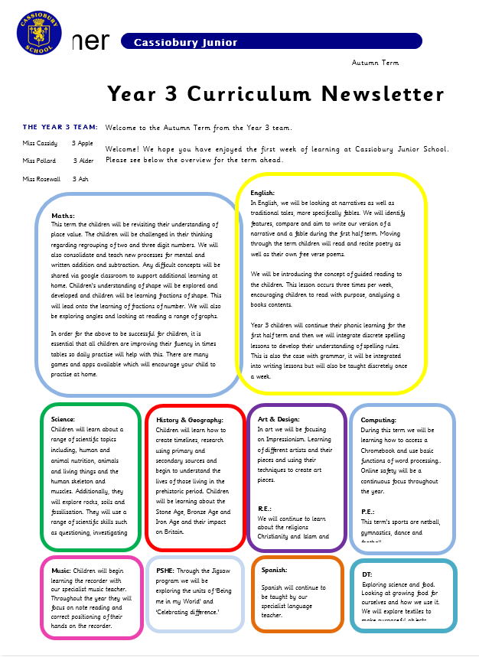
Look out for our curriculum newsletter!

Slide 9
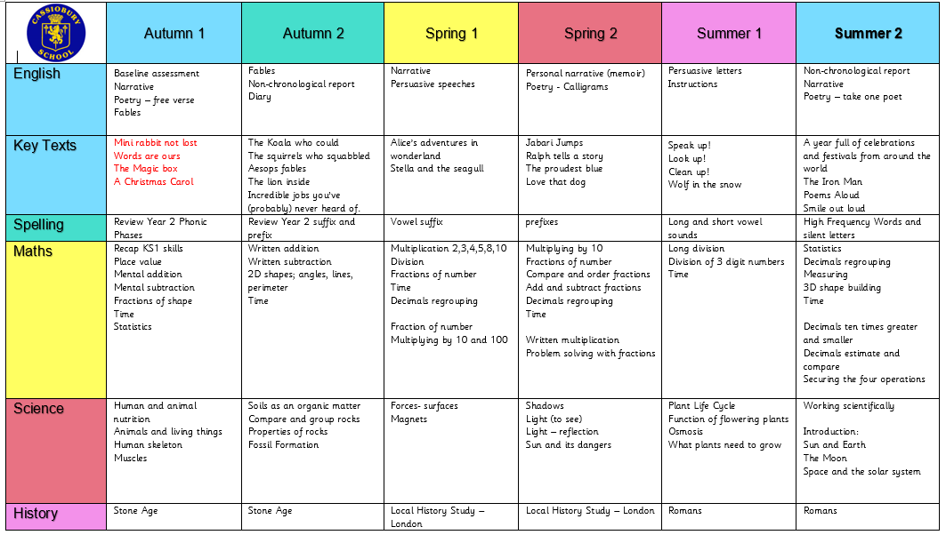
Our Curriculum Overview – on website!

Slide 10
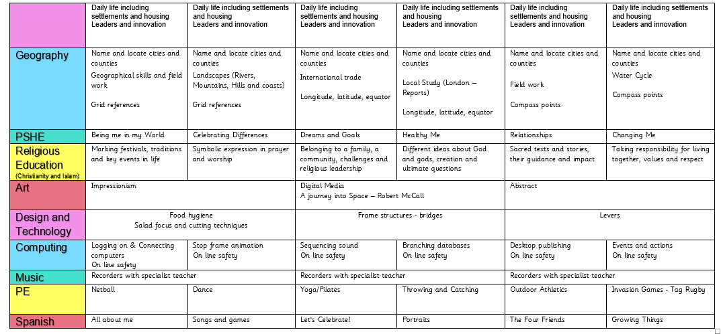
Our Curriculum Overview

Slide 11
Reading
Children will read with an adult at school regularly.
Please ensure their reading book and record is in school everyday.
Children reading up to and including LIME have a focus of reading fluency. Beyond this they are working towards the KS2 targets meaning the focus is comprehension: prediction, retrieval, sequencing, inference & summarise.
Guided reading will occur three times a week.
Library books are a free choice for children and these will be changed weekly.

Slide 12
Phonics & Spelling
Children will be assessed and streamed over the next two weeks, this may mean they are taught by a different adult.
This will be reassessed every five weeks.
Due to our focus on vocabulary and spelling we will be sending home additional spelling lists to consolidate their KS1 common exception words (CEWs).
These will be retested termly.

Slide 13
Homework
Homework is set for year 3 this will consist of timestables, spellings and reading.
Timestables and spellings will be tested weekly.
Homework will be stuck in homework books every Friday, please remember to bring these in every week.
Reading records will also be checked on a Friday – we expect children to have read with an adult at least 3 times a week.

Slide 14
A few things to know….
We do baseline assessments in September
We do formal assessment tests in December and June
We have parent consultations in October and July
We issue our annual report in January as this sets targets for the year.
We update this in July and send it to you.

Slide 15
Parent/teacher appointments and SEND appointments
We do not offer a second meeting if you miss your appointment
In the cases of SEND meetings- we will run the meeting anyway and update the notes.

Slide 16
Additional Information
External clubs need to be contacted directly e.g. football, art, chess, etc
For alternative pick up arrangements, please speak to the class teacher if possible. If not then you can send a note in with your child.
Children in Year 3 are required to bring a pencil case into school, all equipment should be labelled with their name.
Coats and water bottles in school daily please!

Slide 17
What do we need from you…..?
Speak to us if you have a concern
Read the newsletter
Don’t email whilst angry
Be a parent rep
Be a parent governor
Tell us things- keep up the dialogue
Please stick to deadlines

Slide 18
Thank you!

